Slide 1
Energy Deregulation: You Have A Choice
A guide to deregulation and how you can choose savings on your electric & Natural Gas utility bill

Slide 2
What is Deregulation?
Deregulation is the removal of regulations that govern an industry such as Utility companies. This eliminates the monopoly of pricing and supply and allows for retail rate competition amongst suppliers. This allows the consumer to shop supply rates and terms for the electricity and natural gas that is delivered to their home or business without changing utility companies!
How does this work? Flip to the next slide to find out!

Slide 3
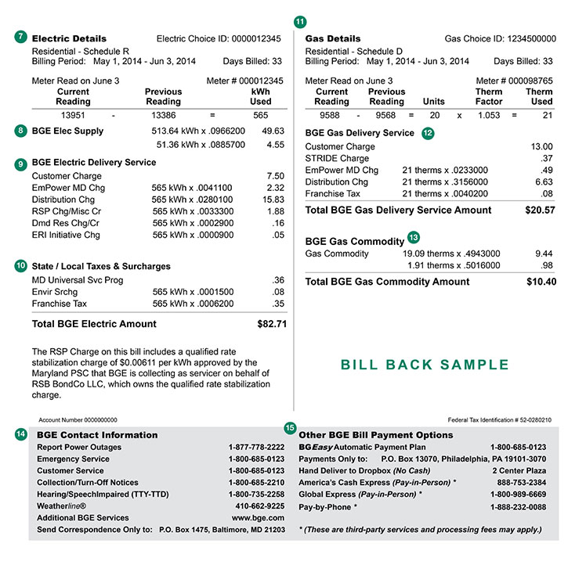
How does this work?
The process is all very simple!
It all starts with your Utility bill!
If you look at the example on the right, you will see a breakdown of Supply and Delivery charges in sections 8 & 9.
Supply (8) is where deregulation comes into play! The usage (kWh) is multiplied by the rate (.0966200 or 9.662 cents per kWh) to calculate your cost for that month!
Because of deregulation, you have the ability to select a new rate (cents/kWh) from a different supplier to save on your energy bill!
Your utility will still deliver the same energy and your distribution charges and methods will stay the same with no interruption in service! The only difference is that supply number on your bill will change to the rate you enrolled with your supplier.

Slide 4
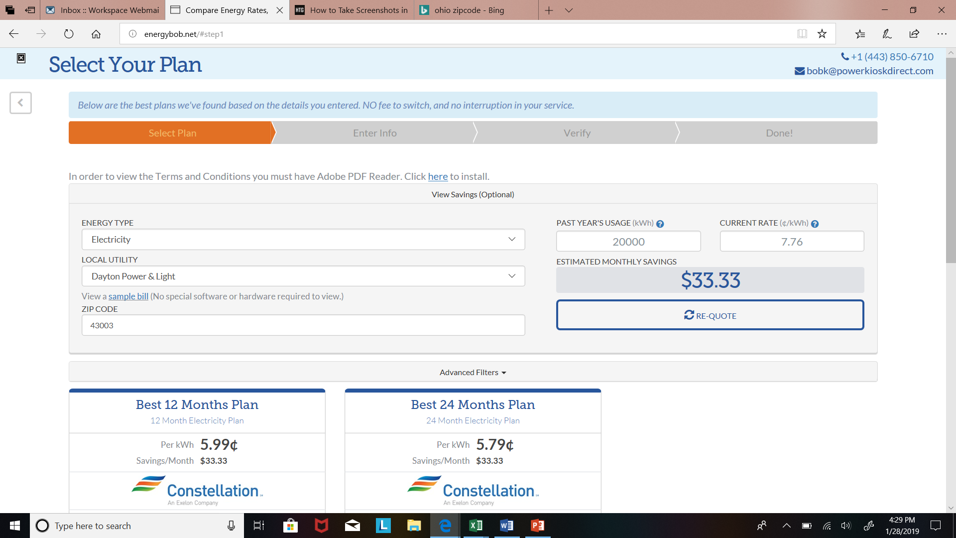
How do I select a new rate and supplier?
Shopping for a new rate and supplier is as easy as booking a hotel room on Hotels.com or Trivago!
Simply go on a website such as www.energybob.net and type your zip code into the search bar! Select the utility you receive your bill from each month and hit Get Rates Now!
You have the option to adjust usage to customize it to your home or business’ average. This will give you a more accurate estimate in savings!
From here, you can scroll through suppliers and rates and choose the option that creates the most savings for you! Recommended options for maximum savings will also be displayed.
A few clicks is all it takes to get you enrolled! The only difference is that you’ll see that new number on your next bill and the consequent savings!

Slide 5
Frequently Asked Questions
Q: Will I receive a disruption in service if I switch suppliers?
A: No – your service will not be affected by the switch. Your utility will continue to distribute it to your home/business with a seamless transition!
Q: If I lose power, will I be the last to be restored since I’m with a different supplier?
A: Absolutely not! You remain on your utility’s same power grid and will receive a restoration in power the same time as your neighbors regardless of supplier choice!
Q: Is there any risk to choosing a 3rd party supplier and who bills me?
A: None whatsoever, and your utility still bills you like they do now. Nothing changes except your rate.

